Slide 1



Value of monitoring facilitating efficient and adaptive biotoxin management in the West Coast Dungeness Crab fishery
Christopher Free, Stephanie Moore, Vera Trainer
OSU Project Team Meeting| November 22, 2021

Slide 2
Project objectives
Demonstrate the value of monitoring in facilitating biotoxin management that protects public health with minimal impacts on fishing opportunities.
Historical synthesis
Synthesize the history of monitoring and management
Identify design principles that facilitate efficient/adaptive management
Opportunity for states to learn from each other and a template for other regions confronting HAB and biotoxin challenges.
Simulation testing
Power analysis to assess the performance of 6-crab surveys
Simulation test programs with different spatial-temporal designs
Demonstrate the effectiveness of monitoring to stakeholders.
Elevate the role of simulation testing in designing monitoring programs.

Slide 3
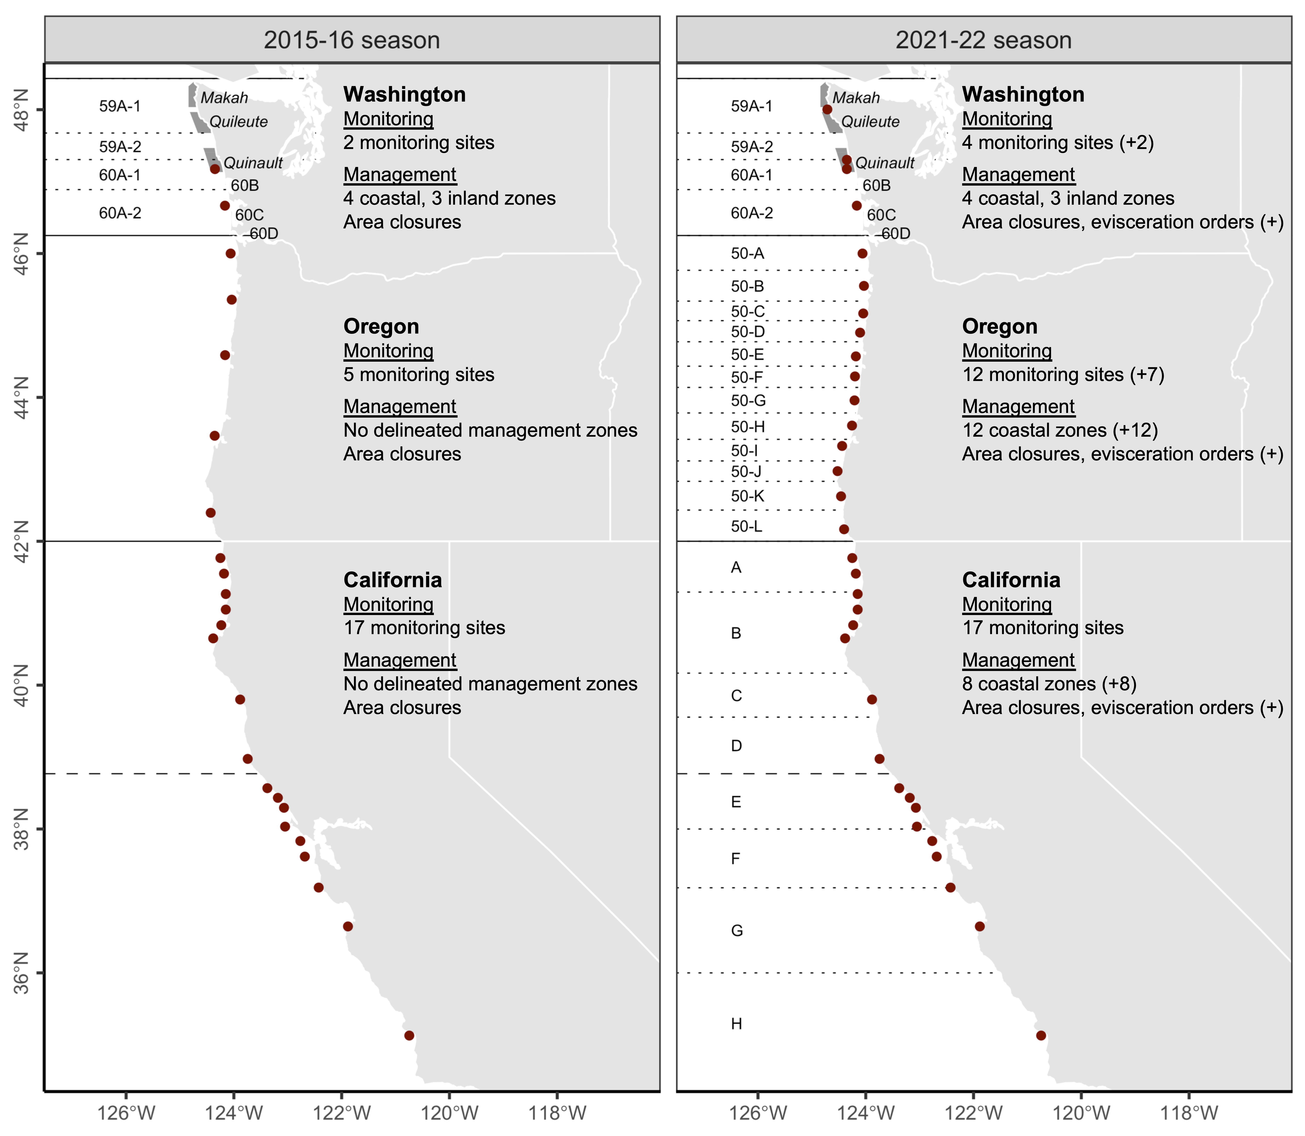
Management changes after the 2015 HAB event
Three major adaptations:
Expansion in monitoring
Delineation of clear mgmt zones
Legalization of evisceration orders

Slide 4
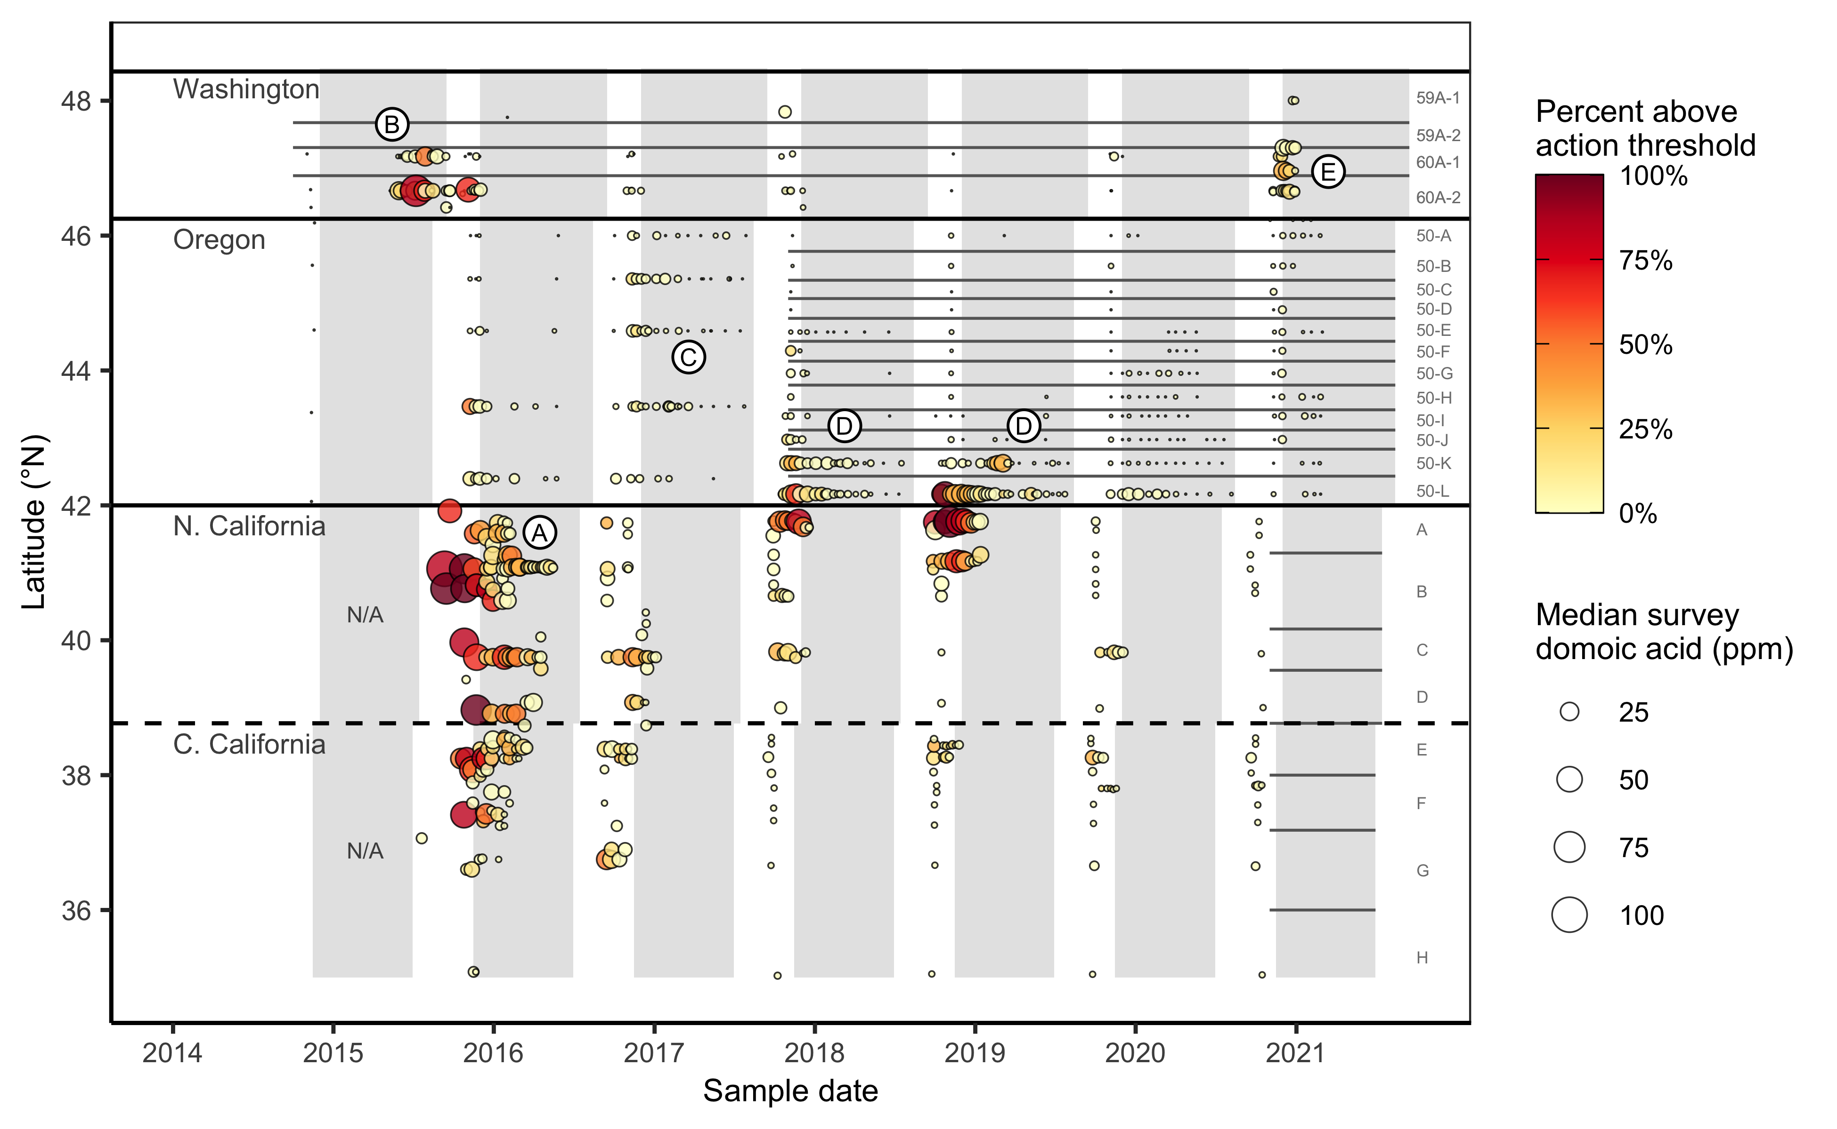
Monitoring history

Slide 5
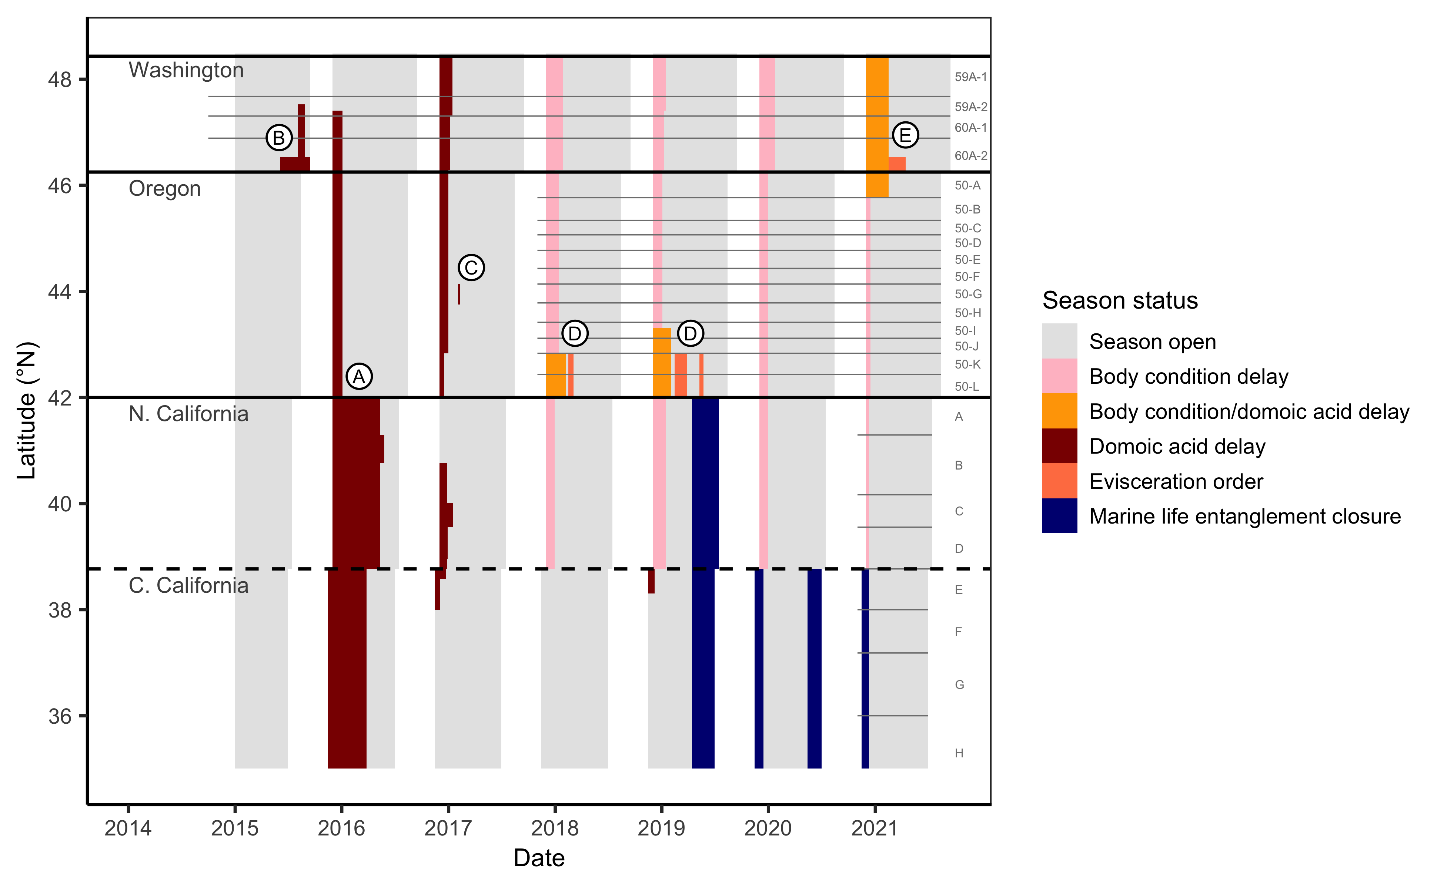
Management history

Slide 6
Is there mid- to late-season contamination risk?
Notes:
3 pieces of evidence

Slide 7
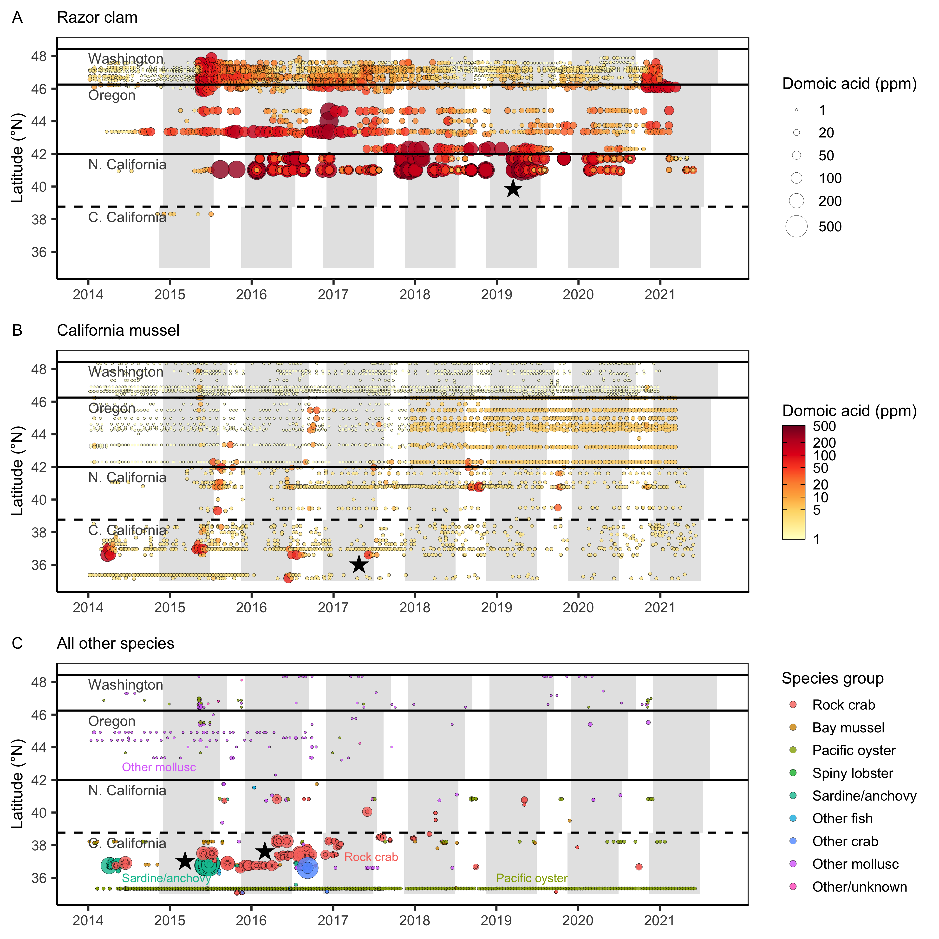
Evidence for mid- to late-season contamination risk

Slide 8
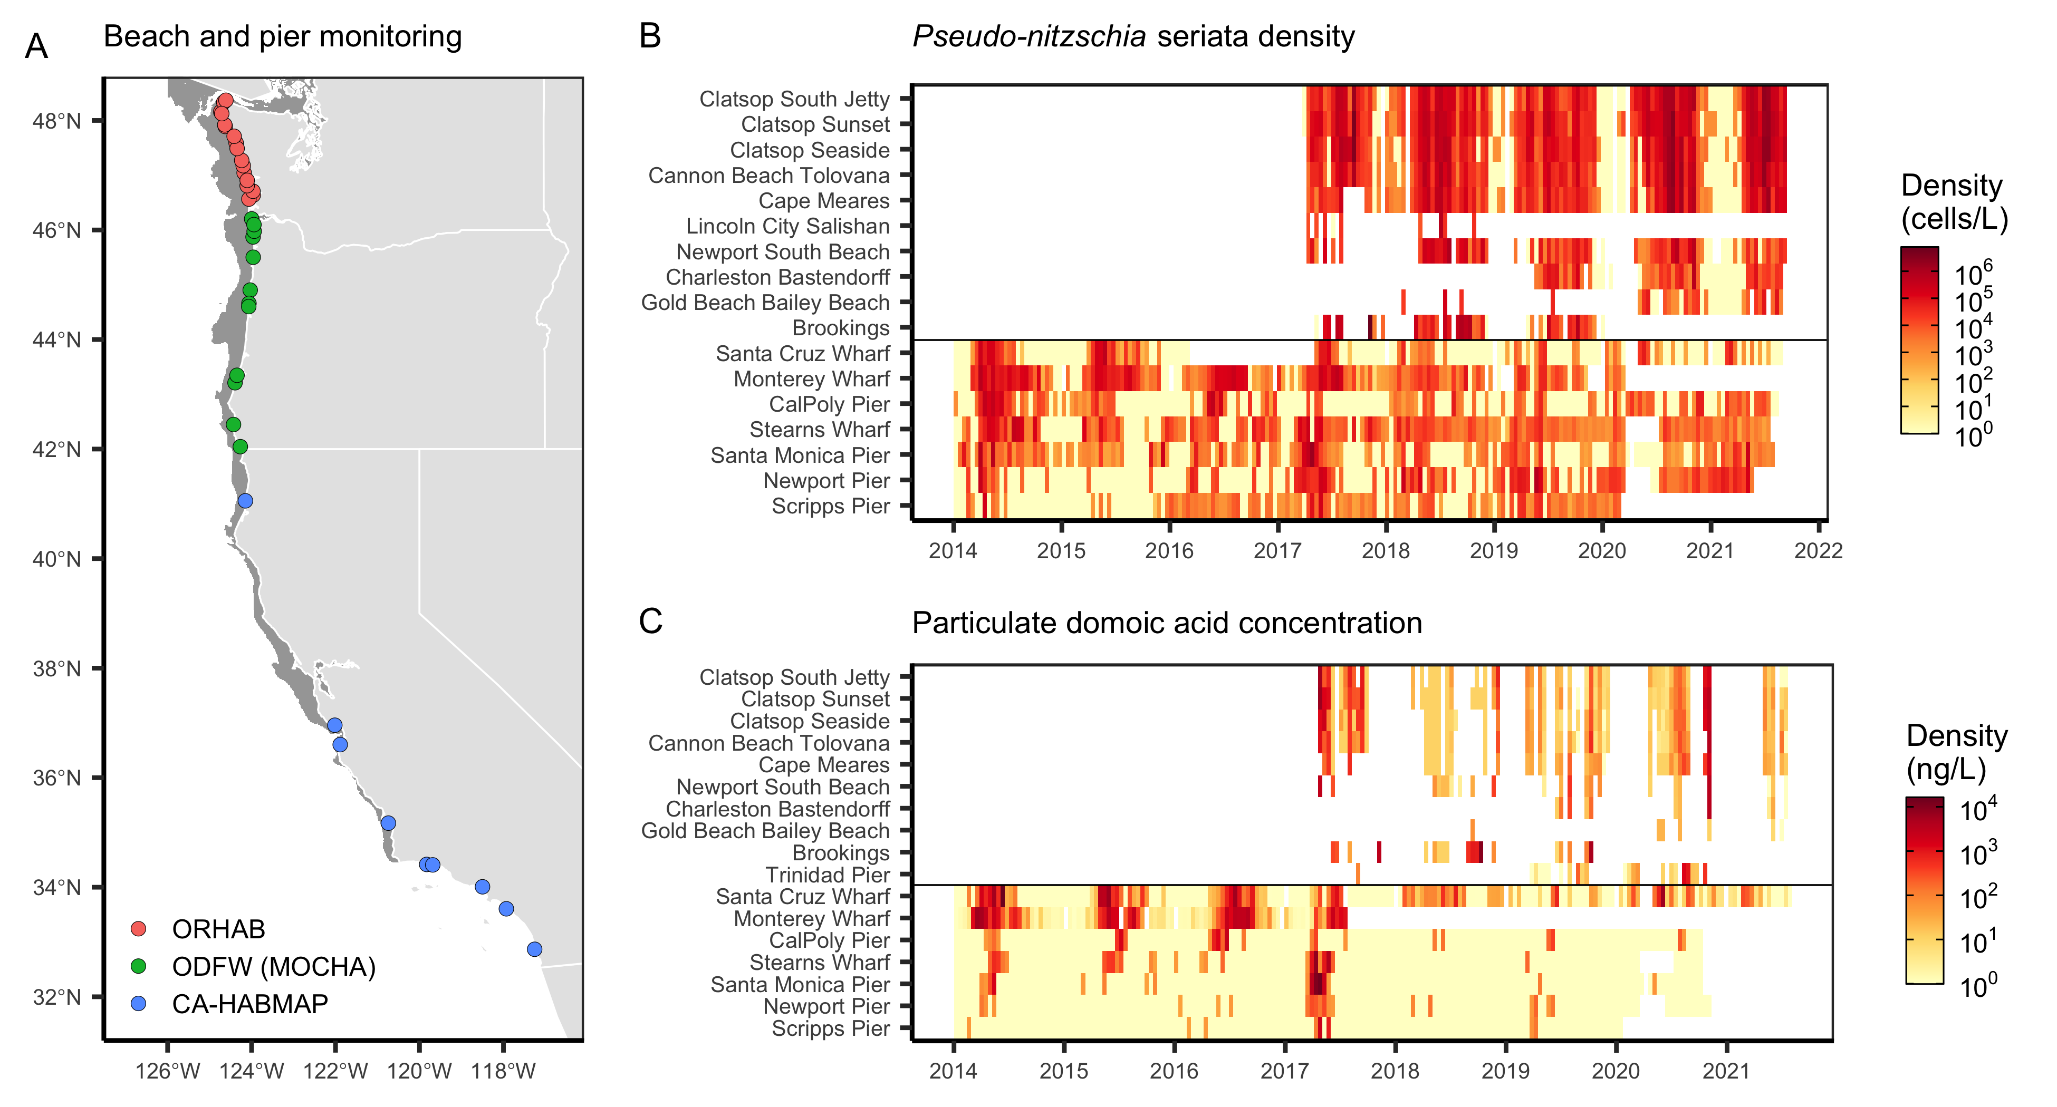
Evidence for mid- to late-season contamination risk

Slide 9
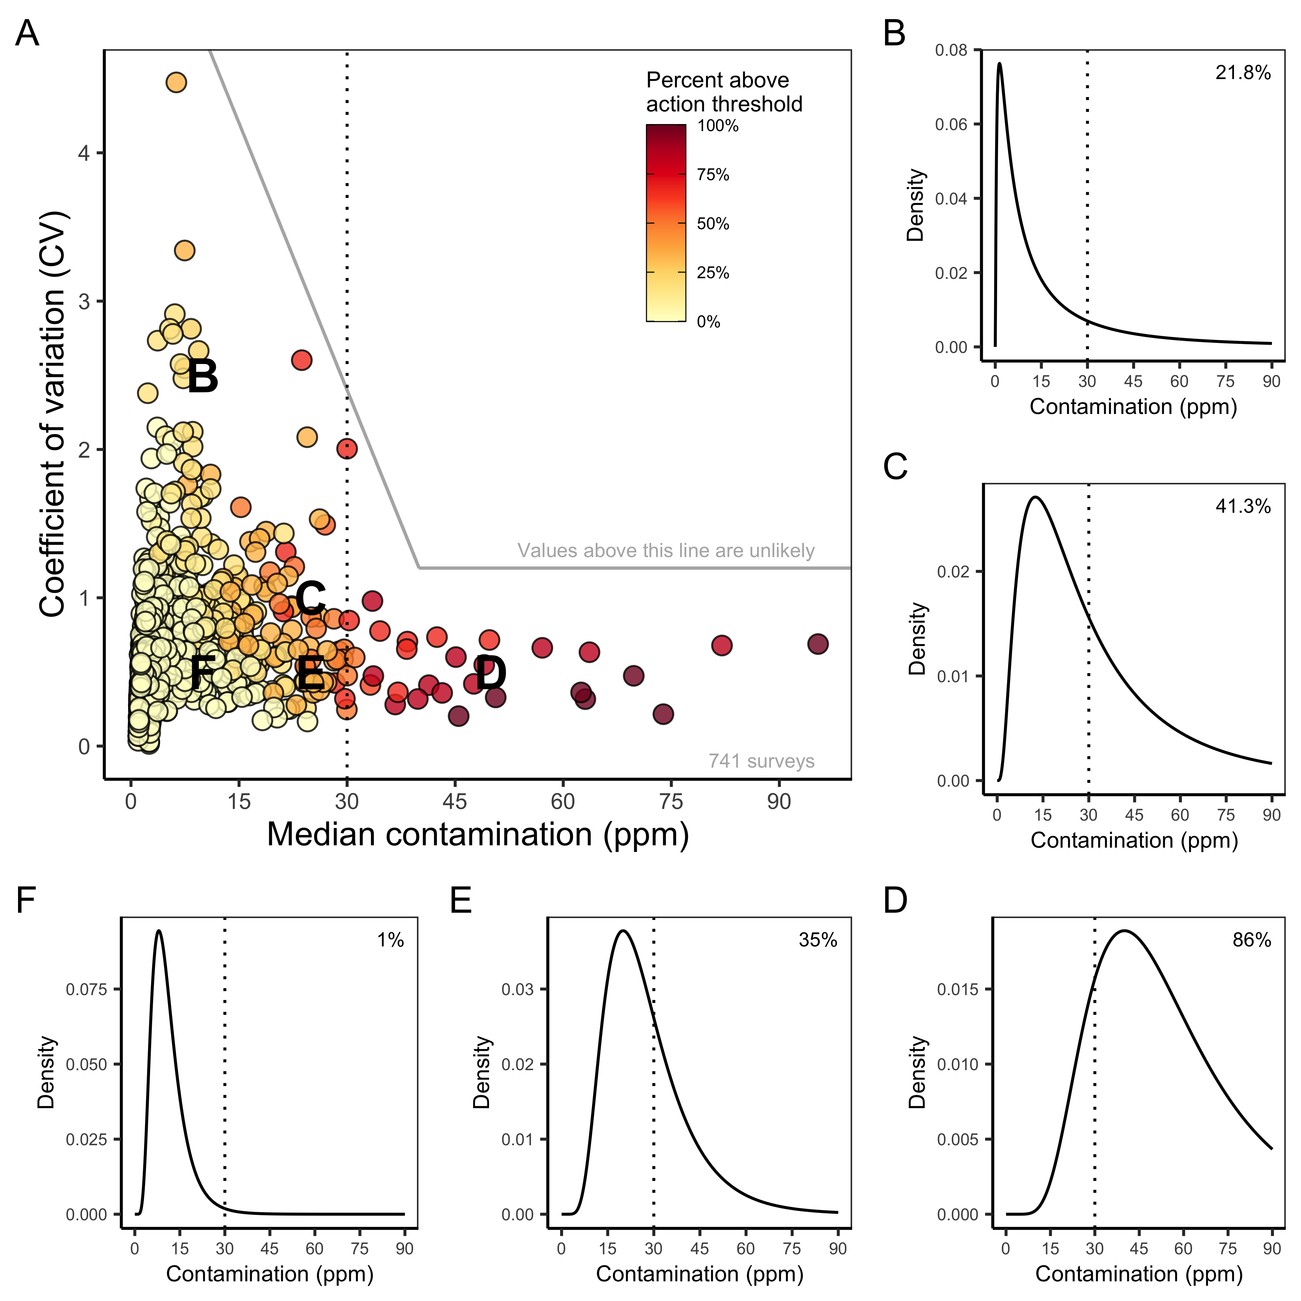
Power analysis

Slide 10
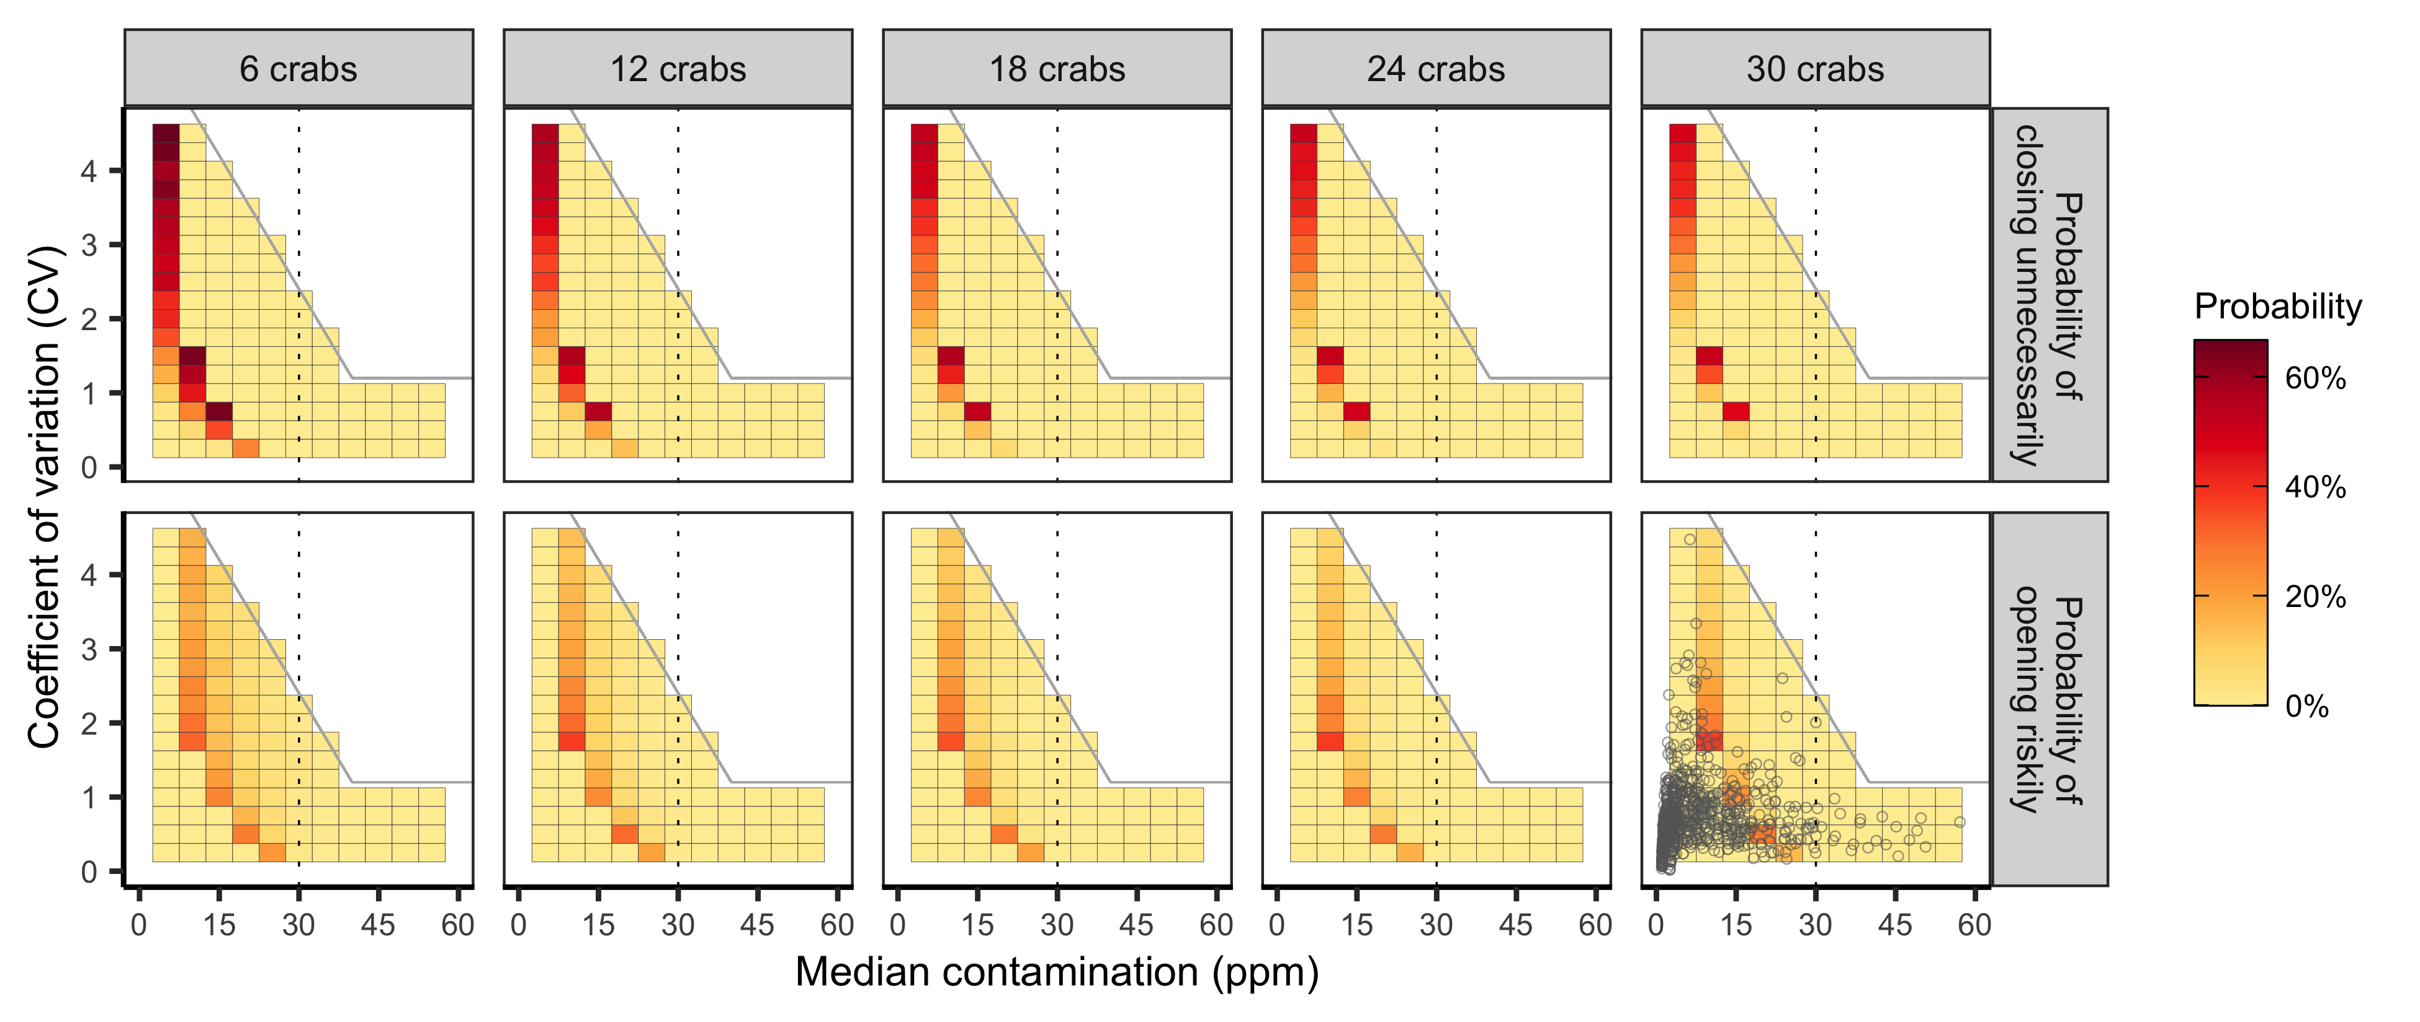
Power analysis

Slide 11
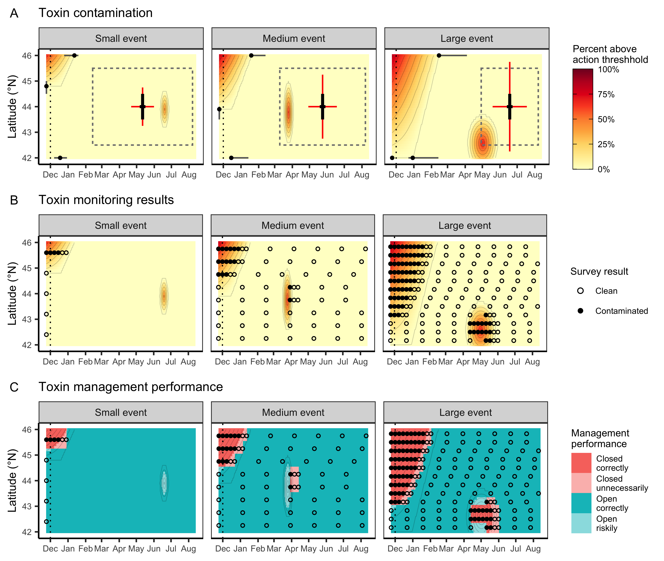
Simulation testing

Slide 12
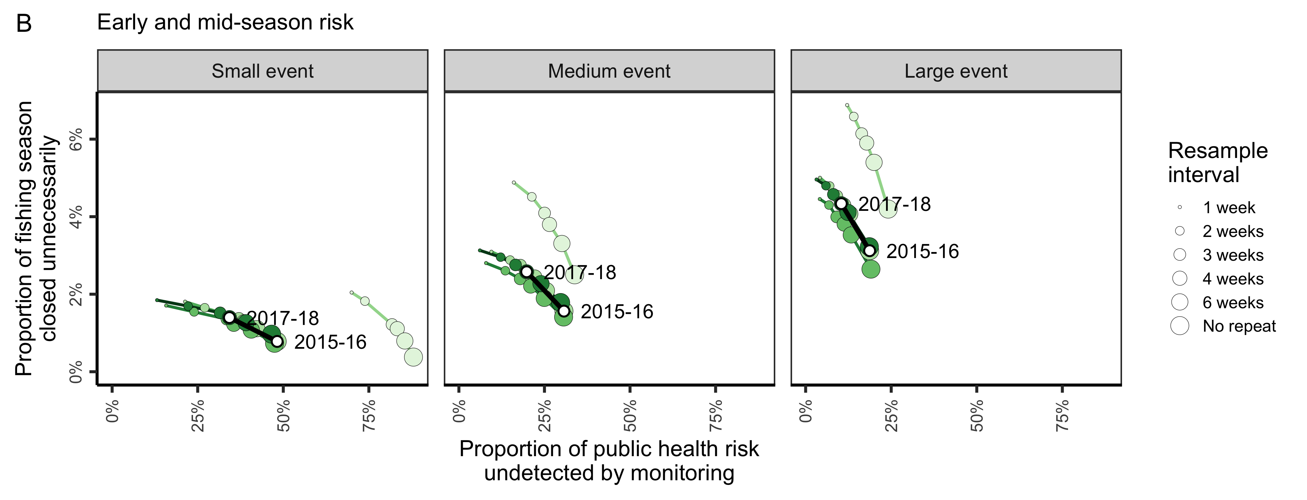
Simulation testing

